Slide 1
Tom Sackville
Executive Director of Services

Slide 2
The plan for today
Welcome and introductions
What to expect from today
What is TUPE?
The proposal for Hillingdon Services
Our Measures including our Staff Structure
Timeline and next steps

Slide 3
What is TUPE?
The Transfer of Undertakings (Protection of Employment Regulations 2006 (TUPE)
When a service transfers from one employer to another under these circumstances there are regulations that apply to protect the employees affected
The legislation designed to protect employees; employment will automatically transfer from to Via on 01 June 2024
Obligations on both transferor and transferee organisations to inform and consult over likely implications of the transfer
Duty is to inform and consult with recognised Trade Union and/or Elected Representatives
Today is the start of Via's (transferee) consultation with you

Slide 4
What inform and consult means for you
ACAS advice is to keep all affected employees updated about the transfer, even if there are representatives
'Inform' is about telling you the facts about the transfer; this information must be provided to you before the transfer takes place on 01 June 2024
'Consult' is when you are asked for your feedback on the changes to working practices ('measures') that the transfer will bring, so that transferor and transferee (Via) organisations may consider your feedback ('representations') before making decisions

Slide 5

Service Delivery Model

Slide 6
Key features of the new Hillingdon Service
Building on existing good practice
Developing volunteering and aftercare pathways
Increasing the voice of those with lived experience
Strengthening local partnership working
Maintaining same service sites
Role of BoB
Teams – Via, BoB, Social Work, Aftercare, YP, Outreach, Rough Sleepers, Group / RDP, Lived experience, Nursing / Clinical, Smoking Cessation
Notes:
Ill populate this next week from the spec. contract

Slide 7
Contract Partnership
Via will be working in a formal sub-contract arrangement with CNWL NHS Trust delivering:
Assessments
Early intervention and harm reduction including BI’s and EBI’s
Psychosocial interventions as 1 – 1 or in groups
Outreach
Criminal justice including DTR’s and ATR’s
Continuity of Care
Volunteering. Recruitment and training and development of pathways

Slide 8
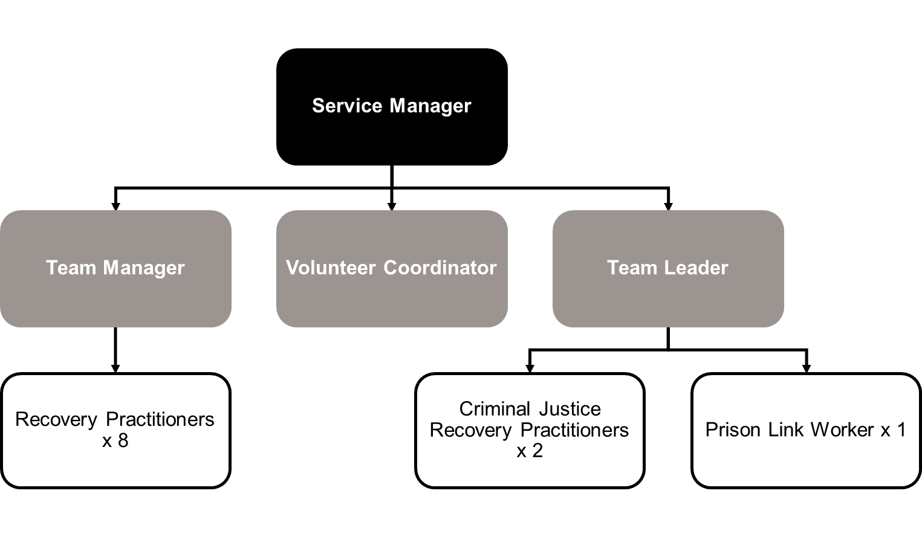
Proposed Hillingdon Staffing Stricture: Via

Slide 9

Measures

Slide 10
Informing & Consulting on the transfer and the TUPE Measures
We are consulting individually and collectively on the process, proposed structure and the other measures.
Initial measures were shared on 22 April 2024: letter available on the microsite
We'll take you through those measures today
They'll be opportunity to further discuss the measures at your 121s, later this week
Feedback and/or written representations are invited
Before we make any final decisions, we'll have informed you of the changes, listened to and fully considered your suggestions and tried to reach agreement

Slide 11
Process
Series of consultation meetings and information providing meetings plus questions can be asked outside of meetings
Collective – 29 April, 121s on 1&2 May, you can bring your employee rep with you
Please review the microsite and unless you work with Via already, complete the new starter forms
Feedback throughout the process
Job matching will then take place
Consultation aims to end by 29 May 2024
Transfer on 1 June 2024, transferring employees will become employees of Via and employment with Humankind will cease on 31 May 2024.

Slide 12
Initial intended measures
Location and Base
Via plan to continue to deliver services from the same primary location. There are no proposed changes to these arrangements.
Operating Hours
The normal operating hours for the new service will be based on the needs of the service and people who use our services. These will be broadly 9am - 5pm Monday to Friday, plus some late evenings and weekend cover, where assessed local need has shown that it is required. Any new hours outside of Monday to Friday 9am - 5pm would be delivered by way of a staff rota and phased introduction.
New Service Structure
In line with the commissioner’s requirements for the service, we will be delivering a refreshed model of service with an adapted staffing structure which will be shared with affected employees and their representatives. We will continue to take feedback on this and the service delivery model during mobilisation. The structure that has been commissioned relates to the delivery of Hillingdon Adult Drug & Alcohol Services. As part of the new proposed structure, it may be that the existing Peer Support Worker post transfers to the Central & North West London NHS Foundation Trust (CNWL).

Slide 13
Initial intended measures
Annual Leave Year
Via operate an April – March annual leave year. Please discharge all outstanding annual leave unless exceptions such as Maternity Leave or Long-Term Sickness Absence.
Level 3 qualification in Substance Misuse (or equivalent)
Employees delivering front line work who do not have a relevant Level 3 qualification, or equivalent, will be supported post transfer to complete the OCN Tackling Substance Misuse Level 3 Qualification. Satisfactory completion of this qualification within reasonable timescales will be an occupational requirement and organisational support will be available. There is no financial cost to individuals in completing this qualification and we welcome all front line employees on to the training, even if they have a similar qualification.
Policies
Employees will no longer follow the current employment related policies or procedures that may be provided as part of due diligence. Employees will transfer to the equivalent Via policies and procedures except for any entitlements to pay or pay related elements which remain part of their contractual terms. This relates to employment related policies, rather than clinical policies, which will still be those of CNWL.

Slide 14
Initial intended measures
Pay
If transferring employees have a contractual pay scale and are entitled to contractual and automatic incremental increases each year, they will move across on their current pay scales and continue to increment to the top of their scale, as they do now. If employees are on a spot salary with no incremental rises, they will transfer on that salary and will remain on this pay point.
Post transfer, pay reviews will be in line with Via’s pay processes and transferring employees will be eligible for Via’s non-contractual pay review. Any contractual payments collectively agreed prior to the transfer date will be paid. Following the legal position, Via will not implement any pay changes negotiated by a previous employer under a collective agreement which takes place after the transfer date.
Pay Date
The pay date will change to the 25th of the month or the nearest Friday if the 25th falls on a weekend or public holiday

Slide 15
Initial intended measures
Pension (for non-statutory pension members):
Via will provide a comparable pension scheme for affected employees. Any employees who are not in a pension scheme at point of transfer will be auto-enrolled into Via’s scheme after 3 months of employment at employee contribution rate of 5% and employer contribution rate of 3% if they meet the eligibility criteria. Employees can specifically request to opt out of this following auto enrolment if they wish.
Employees may also wish to join the scheme on transfer and can contact people@viaorg.uk once they are Via employees, to find out more information. Those who are already in a pension scheme will transfer to Via’s scheme and employer contributions will be matched up to a maximum and employees will continue to pay their employee contribution, although may pay in more if they wish to. The total contribution rate (employer and employee combined) must be a minimum of 8%.
Notes:
Do we need the NHSPS as not an NHS transfer?

Slide 16
Initial intended measures
Job Descriptions
Transferring employees will move to Via’s job descriptions in line with the staffing structure in order that job descriptions reflect the duties of the role and the reporting structure of the organisation. We have received copies of existing job descriptions and will share Via Job Descriptions with affected staff and their representatives on the Via microsite.
Job Titles
Employee job titles may change in line with the job descriptions provided. This is to bring job titles in line with our organisational structures and to ensure that job titles are congruent with the job description and those across the rest of the organisation.

Slide 17
Initial intended measures
Potential Redundancy
We are working hard to ensure no redundancies will occur as a result of the transfer and will confirm this once we have reviewed all the Employee Liability Information and undertaken consultation. In the event of a redundancy situation arising, Via will meet with all statutory redundancy obligations including appropriate consultation.
Trade Union Recognition
Under voluntary recognition arrangements, there is no automatic right for the current terms, agreed between the Trade Union and current provider, to transfer under TUPE for those employees transferring. However, Via are always happy to discuss the possibility of forming new local partnerships with recognised trade unions, in respect of the transferring staff if it is recognised with the current employer.
Death in Service benefit
You'll become a member of the Group Life Assurance Scheme which entitles your next of kin or a nominated person to a tax-free lump sum, should you die in service. This will be 2 x your annual salary
Notes:
Do we want to reword the redundancy section in light of the fact that as it stands there could be one?

Slide 18

Next steps

Slide 19
Timeline and Next Steps
29 April 2024 Consultation starts with this meeting
01 May 2024 121 Consultations commence please book in
27 May 2024 Job matching completed and confirmation of role
29 May 2024 Consultation ends
1 June 2024 Transfer to Via

Slide 20
Timeline and Next Steps
Fri 31 May 2024 Likely last working day with your current employer
Fri 31 May 2024 Last day of employment with your current employer
Sat 01 June 2024 Your employment TUPE transfers to Via
Mon 03 June 2024 First working day

Slide 21
Q&A
Microsite: https://www.viaorg.uk/transfers/Hillingdon/
Password: Hillingdon2024
Any Questions?

